Slide 1


Slide 2
Pseudo-bulges, classical bulges and
elliptical galaxies – I
A Tale of Two Bulges and One Misnomer
Dimitri Gadotti (ESO)

Slide 3
Initial Considerations
Bulges are complex; a difficult, quickly evolving subject
Semantics is (unfortunately) important; some people use the same word to describe different things; there is confusion in the literature, be sure about what authors really mean
There is still too much room for subjective judgment, so it’s important to look at the physics and separate what data tell you from speculation
Previous important references:
  IAU Symp. 153, Ghent, Belgium – ‘92
  Wyse et al. (‘97)
  Kormendy & Kenniccutt (‘04)
  Athanassoula (‘05)
  IAU Symp. 245, Oxford, UK – ‘07
All we want is to understand how stellar systems form and evolve
Francesco Lucchin PhD School – Erice 2011
Dimitri Gadotti (ESO)

Slide 4
Outline – Lecture One
Bulge definitions
Bulge types: classical, pseudo and box/peanuts
Identifying pseudo-bulges
  morphology
  the Sérsic index
  the Kormendy relation
Structural parameters and scaling relations (e.g. the fundamental plane)
The stellar mass budget at redshift zero
Francesco Lucchin PhD School – Erice 2011
Dimitri Gadotti (ESO)

Slide 5
Outline – Lecture Two
Composite bulges
Host galaxies and environment
Elliptical galaxies and two dichotomies
  core-depleted vs. extra-light
  giants vs. dwarfs
Supermassive black holes and their scaling relations
Bulge formation models
Some thoughts on future research
Francesco Lucchin PhD School – Erice 2011
Dimitri Gadotti (ESO)

Slide 6
Bulge Definitions
What is a bulge? It’s not an easy question and, in fact, we still lack a definition for what is a galaxy (Forbes & Kroupa ‘11).
From morphology
One of the criteria in the Hubble (‘26) classification of disk galaxies:
“relative size of the unresolved nuclear region”, elliptical-like, changes monotonically along the sequence
led to the concept that disk galaxies are like elliptical galaxies (the bulge) surrounded by disks.
Francesco Lucchin PhD School – Erice 2011
Dimitri Gadotti (ESO)

Slide 7
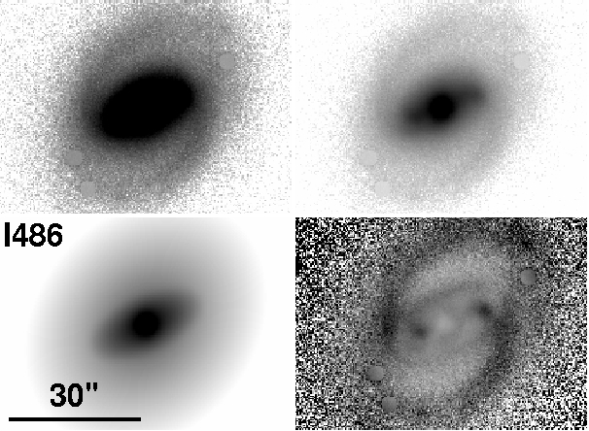
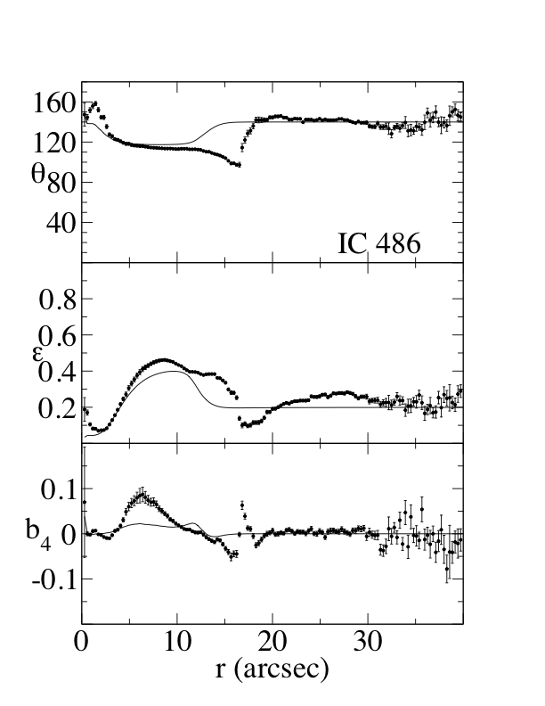
Bulge Definitions
From morphology (isophotal maps; ellipse fits in IRAF –Jedrzejewski ‘87)
N
E
Gadotti ‘08
Francesco Lucchin PhD School – Erice 2011
Dimitri Gadotti (ESO)

Slide 8
Bulge Definitions
From morphology
Pros:
Physical
Cons:
Somewhat subjective; arbitrary (how much difference in θ or ε is enough?)
“Bulge” can be a lot of different things
Francesco Lucchin PhD School – Erice 2011
Dimitri Gadotti (ESO)

Slide 9
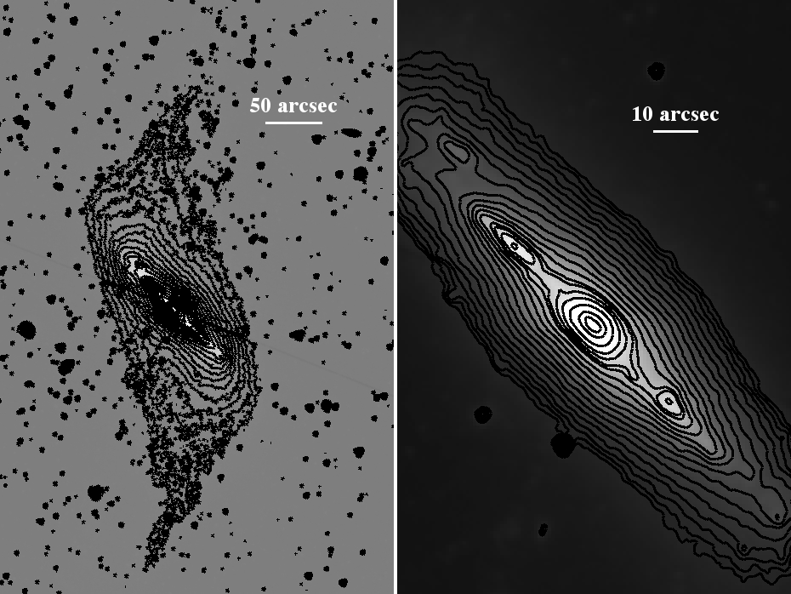
Bulge Definitions
From geometry (everything above the disk plane)
thick disk?
Gadotti et al., in prep. – Spitzer 3.6μm S⁴G image of NGC 660
Francesco Lucchin PhD School – Erice 2011
Dimitri Gadotti (ESO)

Slide 10
Bulge Definitions
From geometry
Pros:
Easy, can be objective
Cons:
Only works for very inclined galaxies
Somewhat arbitrary
“Bulge” can be a lot of different things
Francesco Lucchin PhD School – Erice 2011
Dimitri Gadotti (ESO)

Slide 11
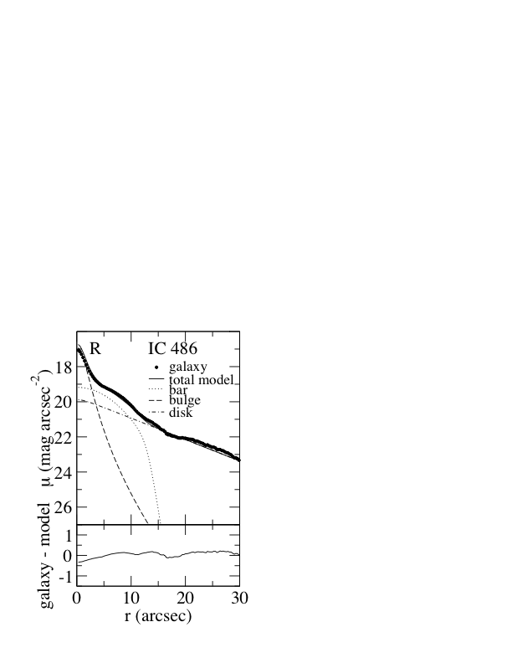
Bulge Definitions
From photometry (excess above inner extrapolation of disk intensity radial profile)
μ
r
disks seem to be well described with at least 1 exponential
Gadotti ‘08
Francesco Lucchin PhD School – Erice 2011
Dimitri Gadotti (ESO)

Slide 12
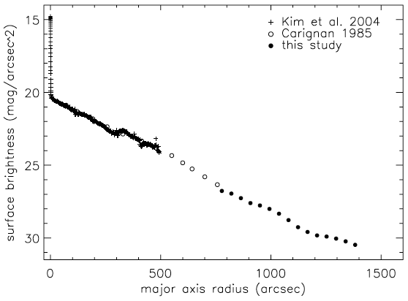
Bulge Definitions
From photometry
Pros:
Objective, can be reproduced (most times)
Cons:
“Bulge” can be a lot of different things (e.g. nuclear cluster in NGC 300)
Bland-Hawthorn et al. ‘05
Francesco Lucchin PhD School – Erice 2011
Dimitri Gadotti (ESO)

Slide 13
Bulge Definitions
Bulges seem to be everything but the disk!
Photometric definition is better suited most times, leading to the concept of ‘photometric bulge’, as a separate entity from the disk. Further analysis might reveal what the photometric bulge is consisted of physically.
Francesco Lucchin PhD School – Erice 2011
Dimitri Gadotti (ESO)

Slide 14
Bulge Types
Classical bulges
  stick out of disk plane, i.e. not as flat as the disk (when seen at sufficient inclinations)
  more or less spheroidal (hard to see at low inclinations)
  featureless (no spiral arms, bars, rings…)
  mostly old stars (no much dust or star-forming regions)
  kinematically hot, i.e. dynamically supported by stellar velocity dispersion σ
  seem to be built mostly by mergers (accretion of usually smaller exterior units), in violent events, inducing fast bursts of star formation if gas is available
Francesco Lucchin PhD School – Erice 2011
Dimitri Gadotti (ESO)

Slide 15
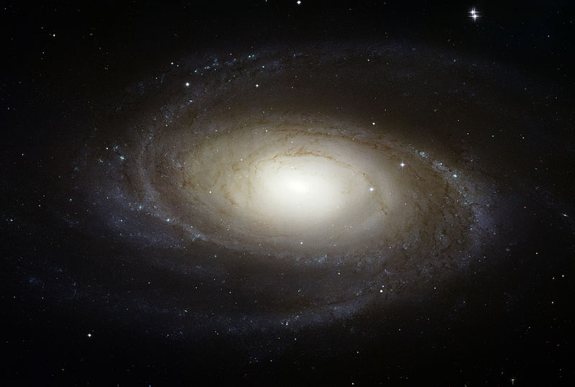
Bulge Types
Classical bulges: e.g. M81 [NASA, ESA and the Hubble Heritage Team (STScI/AURA)]
Francesco Lucchin PhD School – Erice 2011
Dimitri Gadotti (ESO)

Slide 16
Bulge Types
Disk-like bulges (aka pseudo-bulges)
  as flat (or almost as flat) as the disk (not easy to see in very inclined galaxies)
  may contain sub-structures such as nuclear bars, spiral arms, rings…
  usually show signs of dust obscuration, young stellar populations or ongoing star formation
  kinematically cold, i.e. dynamically supported by rotation of its stars V_{rot}
  seem to be built mostly via disk instabilities (mainly bars but also possibly spiral arms and ovals) in a relatively continuous, smooth process
Francesco Lucchin PhD School – Erice 2011
Dimitri Gadotti (ESO)

Slide 17
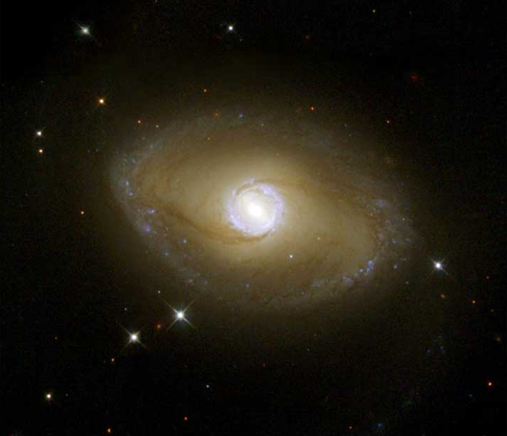
Bulge Types
Disk-like bulges (aka pseudo-bulges): e.g. NGC 6782 [NASA, ESA and the Hubble Heritage Team (STScI/AURA)]
Francesco Lucchin PhD School – Erice 2011
Dimitri Gadotti (ESO)

Slide 18
Bulge Types
Box/Peanut bulges (aka pseudo-bulges)
  stick out of the disk plane (not easy to see at low inclinations)
  show a boxy or peanut-like morphology
  usually featureless (no sub-structures, such as spiral arms, bars or rings)
  usually does not show signs of dust obscuration, young stellar populations or star-forming regions
  kinematically cold, i.e. dynamically supported by rotation of its stars V_{rot}
  are not bulges but the inner parts of bars
Francesco Lucchin PhD School – Erice 2011
Dimitri Gadotti (ESO)

Slide 19
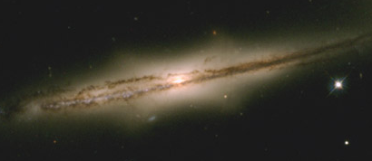
Bulge Types
Box/Peanut bulges (aka pseudo-bulges): e.g. ESO 597-G 036 [NASA, ESA and the Hubble Heritage Team (STScI/AURA)]
Francesco Lucchin PhD School – Erice 2011
Dimitri Gadotti (ESO)

Slide 20
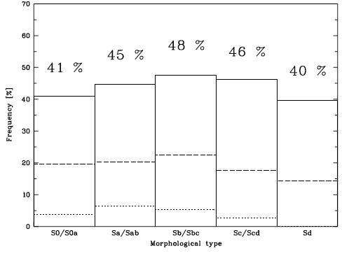
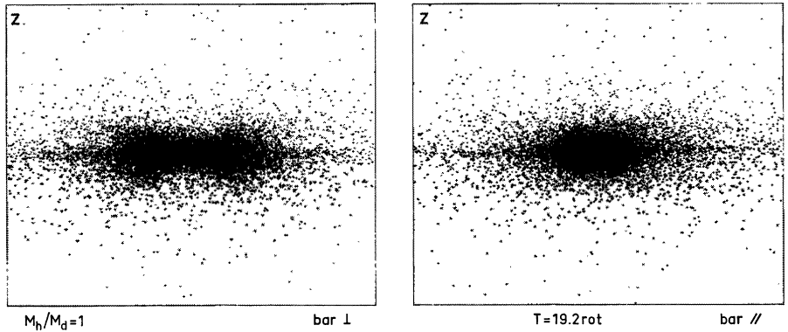
B/Ps and Bars
Suggestive evidence that box/peanuts are associated with bars, from statistical considerations, go at least as far as the 80’s (e.g. de Souza & dos Anjos ‘87; see also Luetticke et al. ‘00). Distribution of bps in morphological types in edge-on galaxies is similar to the corresponding distribution of strong bars in face-on galaxies.
Bars seen edge-on in N-body simulations were known to show bp structure from dynamical processes (e.g. Combes & Sanders ‘81).
Francesco Lucchin PhD School – Erice 2011
Dimitri Gadotti (ESO)

Slide 21
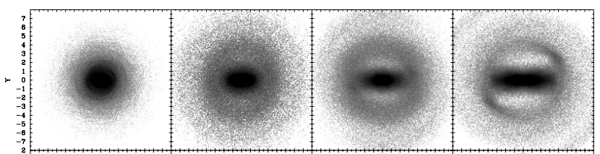
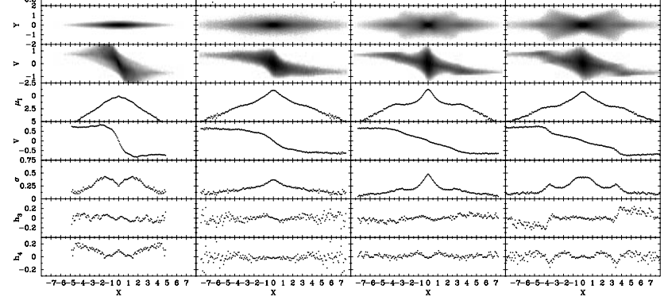
Bureau & Athanassoula ’05: state-of-the-art N-body simulations reveal bar signatures that can be tested with observations of galaxies showing bp.
no bar
weak bar
intermediate bar
strong bar
LOS
Side on
PVD
μ
Vrot
σ
h₃
h₄

Slide 22
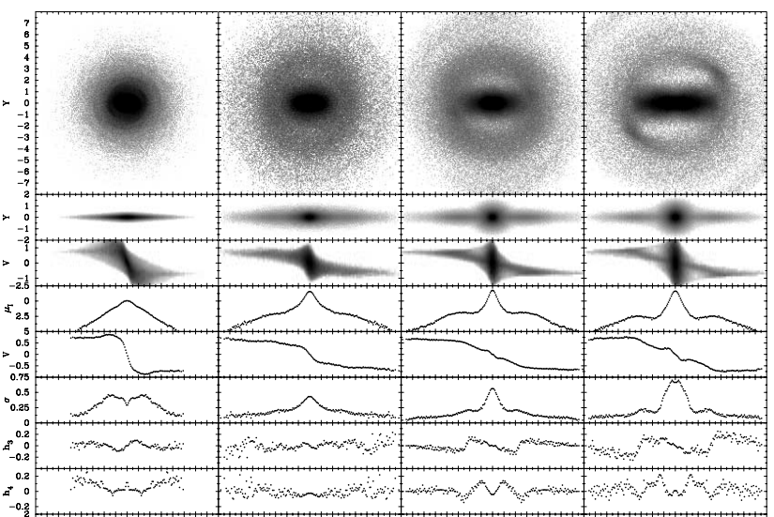
Bureau & Athanassoula ’05: state-of-the-art N-body simulations reveal bar signatures that can be tested with observations of galaxies showing bp.
no bar
weak bar
intermediate bar
strong bar
LOS
End on
PVD
μ
Vrot
σ
h₃
h₄

Slide 23
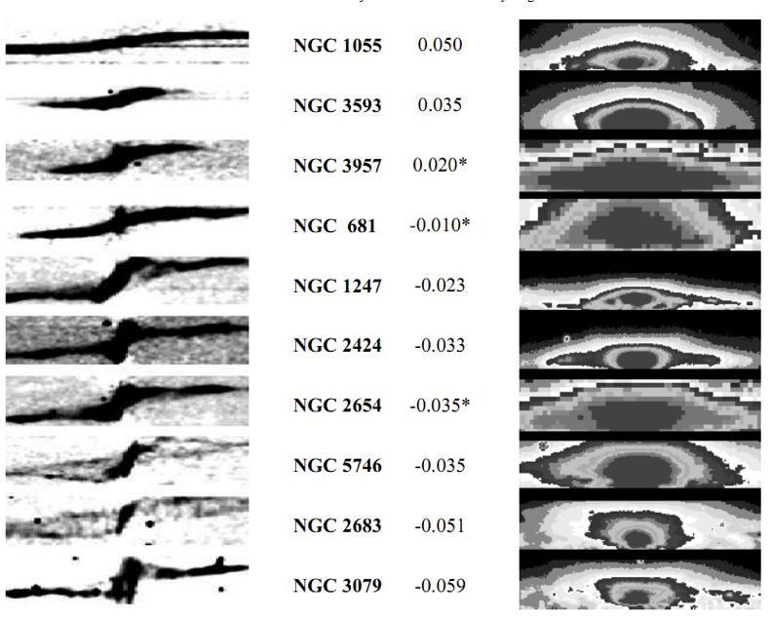
Merrifield et al. ’99: use (gas) [NII] 6584Å emission to find evidence for the connection between bps and bars. Position-velocity diagrams of bps show clear bar signature (see also Kuijken & Merrifield ‘95).
PVD
boxyness
disky
boxy

Slide 24
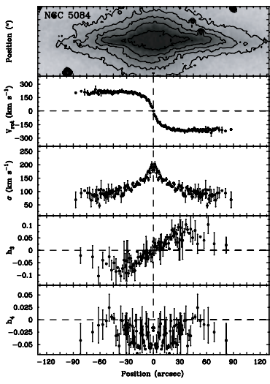
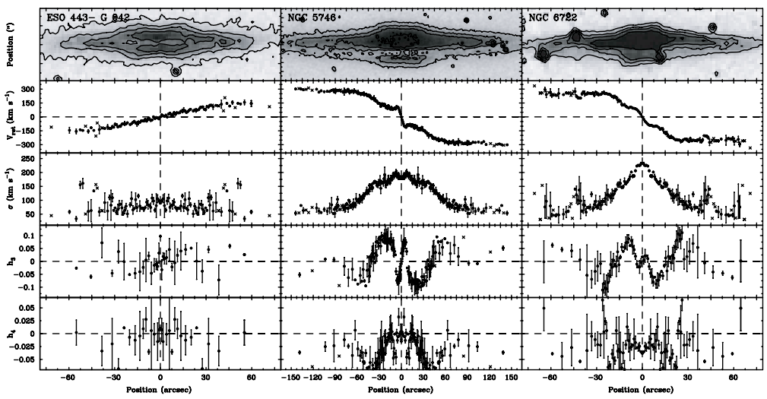
B/Ps and Bars
Chung & Bureau ’04 use stellar kinematics and find further evidence.
Francesco Lucchin PhD School – Erice 2011
Dimitri Gadotti (ESO)

Slide 25
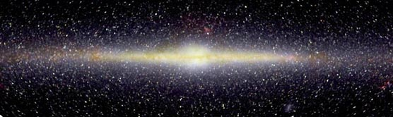
B/Ps and Bars
Box/Peanuts are the inner parts of bars, vertically thickened by dynamical processes.
Box/Peanuts are NOT bulges, in the sense that they are not a distinct physical component.
I am NOT going to talk about them here.
Milky Way “bulge” is known to show bp morphology since the 90’s, with COBE.
The COBE Project, DIRBE, NASA
Francesco Lucchin PhD School – Erice 2011
Dimitri Gadotti (ESO)

Slide 26
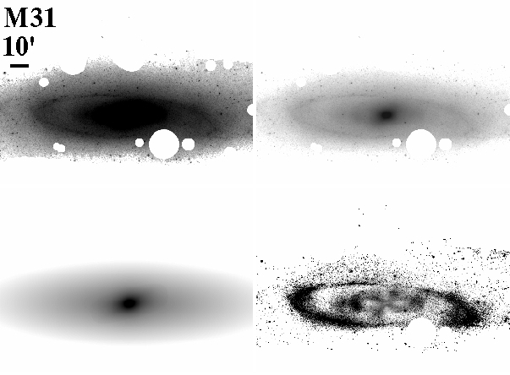
B/Ps and Bars
M31 is a remarkable case (see e.g. Athanassoula & Beaton ‘06). Erwin & Gadotti (in prep.) show a BUDDA (de Souza et al. ’04; Gadotti ‘08) decomposition of M31, using a Spitzer 3.6μm image. The X-shape, clear signature of the bp, is evident in the residual image.
Francesco Lucchin PhD School – Erice 2011
Dimitri Gadotti (ESO)

Slide 27
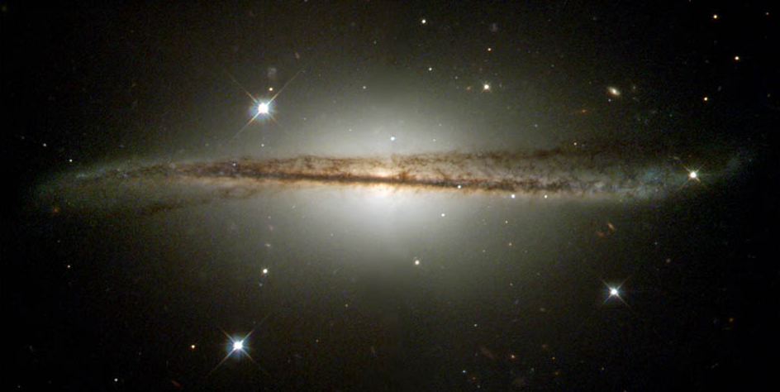
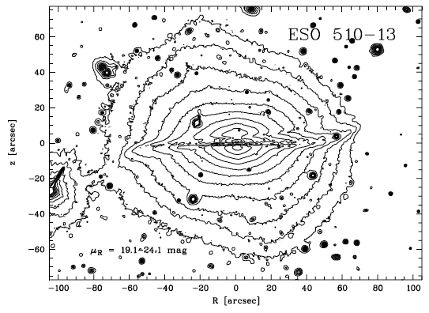
B/Ps and Bars
A caveat: some bulges with boxy morphology might be in fact classical bulges built by mergers (see Luetticke et al. ’04).
NASA, ESA and the Hubble Heritage Team (STScI/AURA)
Francesco Lucchin PhD School – Erice 2011
Dimitri Gadotti (ESO)

Slide 28
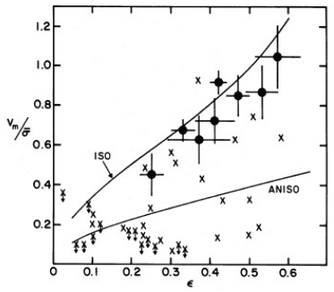
The Dynamical Support of Bulges
Kormendy & Illingworth ‘82: bulges are isotropic, oblate rotators, unlike (massive) ellipticals. Some bulges appear to have dynamical support similar to ellipticals, but many (classical) bulges seem to have more rotational support.
Francesco Lucchin PhD School – Erice 2011
Dimitri Gadotti (ESO)

Slide 29
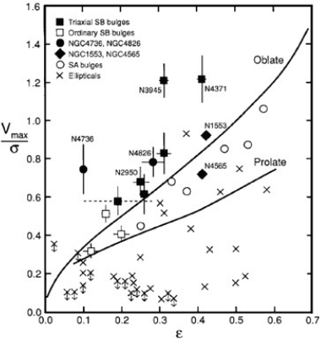
The Dynamical Support of Bulges
Kormendy ‘93: some bulges are really disks! Some of these are box/peanuts. They are more rotationally supported than pressure supported.
Francesco Lucchin PhD School – Erice 2011
Dimitri Gadotti (ESO)

Slide 30
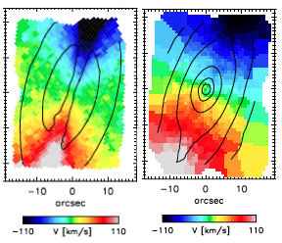
The Dynamical Support of Bulges
More recently, the SAURON team (e.g. Emsellem et al. ’04; Falcon-Barroso et al. ’06; Ganda et al. ’06) obtained 2D kinematical data and found examples of usual bulge rotation, as well as cylindrical rotation in bars.
usual rotation
cylindrical rotation
Francesco Lucchin PhD School – Erice 2011
Dimitri Gadotti (ESO)

Slide 31

Identifying Disk-like Bulges
From morphology, i.e. looking for signatures of sub-structures, such as inner bars, spiral arms or rings, or dust obscuration or star formation regions. A vertically thin bulge can also be a disk-like bulge. This is of course subjective (see e.g. Fisher & Drory ‘10).
From the Sérsic index. There is evidence that disk-like bulges, as disks, have intensity radial profiles well described by an exponential function, which translates to a Sérsic index n = 1. The Sérsic function is:
where μ_{e} is the effective surface brightness, c_{n} depends on n, r_{e} is the effective radius, and n is the Sérsic index. Thus, Fisher & Drory (‘08), among others, use a threshold at n < 2 to define such bulges as pseudo-bulges. It is not well understood physically why it should be so. Also, the uncertainty in n is typically about 0.5 (see Gadotti ‘08; ‘09), which can lead to many misclassifications.
Francesco Lucchin PhD School – Erice 2011
Dimitri Gadotti (ESO)

Slide 32
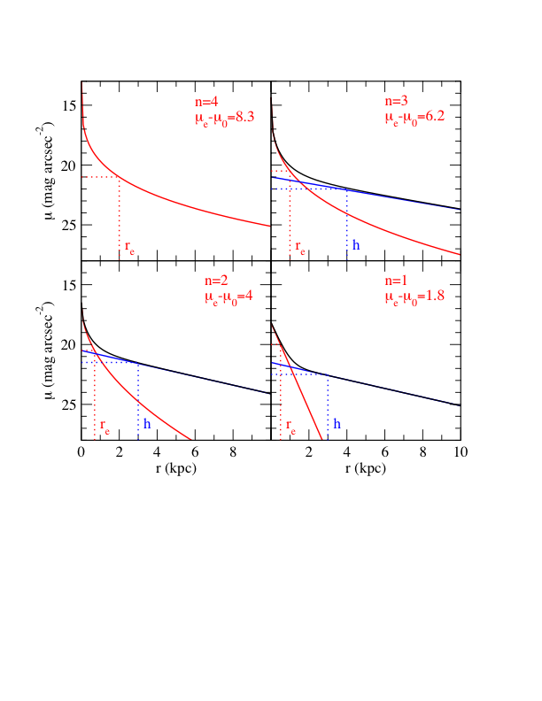
Identifying Disk-like Bulges
Usually, elliptical galaxies have higher values of n (n = 4 is the famous de Vaucouleurs ‘48 profile). Bulge parameters can be obtained via decomposition.
classical
disk-like
Francesco Lucchin PhD School – Erice 2011
Dimitri Gadotti (ESO)

Slide 33
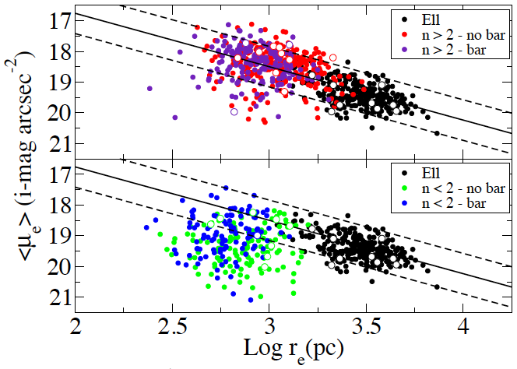
Identifying Disk-like Bulges
From the Kormendy (‘77) relation, a projection of the fundamental plane followed by ellipticals. Disk-like bulges can be identified as outliers (Gadotti ‘09). This is more physically motivated.
Francesco Lucchin PhD School – Erice 2011
Dimitri Gadotti (ESO)

Slide 34
Identifying Disk-like Bulges
From the Kormendy (‘77) relation, a projection of the fundamental plane followed by ellipticals. Disk-like bulges can be identified as outliers (Gadotti ‘09). This is more physically motivated.
Disk-like bulges satisfy (SDSS i-band):
Francesco Lucchin PhD School – Erice 2011
Dimitri Gadotti (ESO)

Slide 35
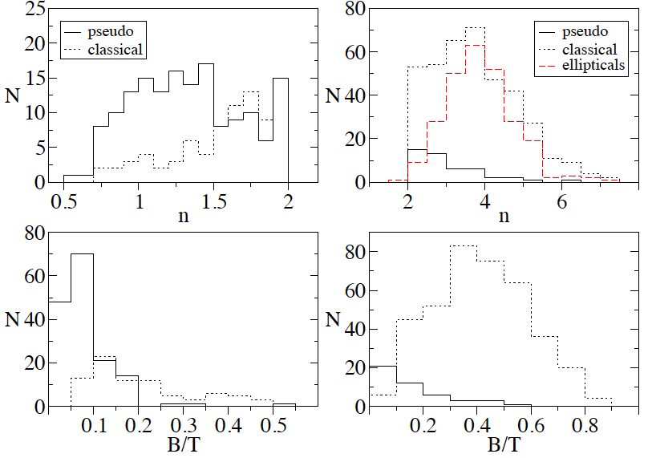
Identifying Disk-like Bulges
n<2
n>2
Gadotti ‘09
Francesco Lucchin PhD School – Erice 2011
Dimitri Gadotti (ESO)

Slide 36
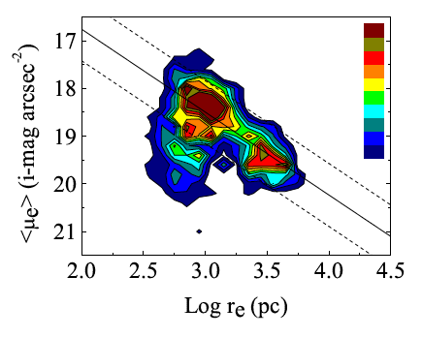
Identifying Disk-like Bulges
Disk-like bulges, classical bulges and elliptical galaxies are clearly isolated in this diagram, indicating that the separation is not artificial, but has solid physical grounds.
A section with composite bulges can also be seen between classical and disk-like bulges.
Gadotti ‘09
Francesco Lucchin PhD School – Erice 2011
Dimitri Gadotti (ESO)

Slide 37
Identifying Disk-like Bulges
A promising way to identify disk-like bulges is of course from kinematics, but more work is needed, and it is expensive in terms of telescope time.
Francesco Lucchin PhD School – Erice 2011
Dimitri Gadotti (ESO)

Slide 38



The Fundamental Plane
From the Virial Theorem:
average kinetic energy
average potential energy
for any bound system of particles interacting by means of an inverse-square force, and with a number of non-trivial assumptions (see e.g. Zaritsky et al. ‘06),
or
Francesco Lucchin PhD School – Erice 2011
Dimitri Gadotti (ESO)

Slide 39
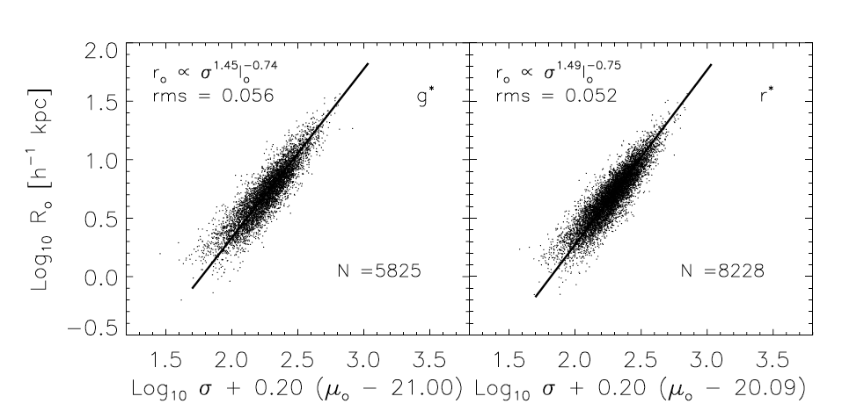
or
And this is what we observe for early-type galaxies (Bernardi et al. ‘03):
Francesco Lucchin PhD School – Erice 2011
Dimitri Gadotti (ESO)

Slide 40
The difference between the expected and observed coefficients is called the tilt of the FP.
Why is there a tilt (see e.g. Trujillo et al. ‘03)?
  mostly: systems are not homologous, i.e. the shape of the potential might depend on scale, system size (indeed, the Sersic index varies with galaxy luminosity)
  but also: variations in mass-to-light ratio (also as a function of luminosity)
Francesco Lucchin PhD School – Erice 2011
Dimitri Gadotti (ESO)

Slide 41
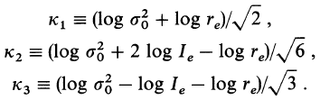
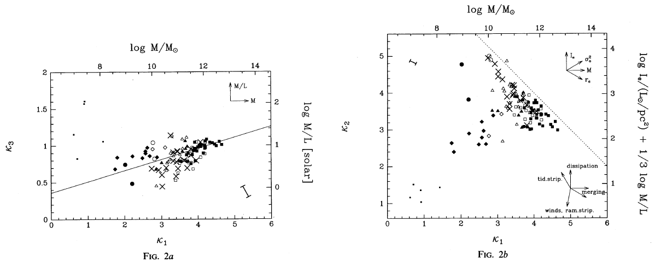
The FP can also be formulated as (Bender et al. ‘92):
Francesco Lucchin PhD School – Erice 2011
Dimitri Gadotti (ESO)

Slide 42
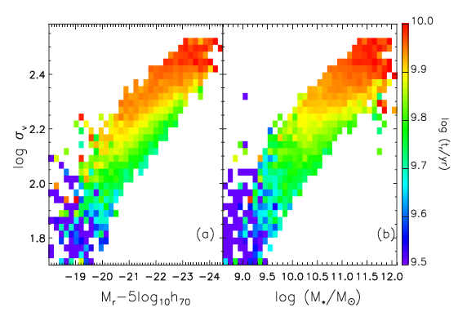
Projections of the FP are also important relations.
  The Faber-Jackson (‘76) relation:
  where γ should be 4 (from its derivation), but is observed to be ~ 8 for early-type galaxies (Gallazzi et al. ’06).
curvature, or a variation in slope with magnitude can indicate different formation histories – more dissipation for fainter galaxies
(see e.g. Desroches et al. ‘07)
stellar mass
(slope ~ 3.5)
Francesco Lucchin PhD School – Erice 2011
Dimitri Gadotti (ESO)

Slide 43
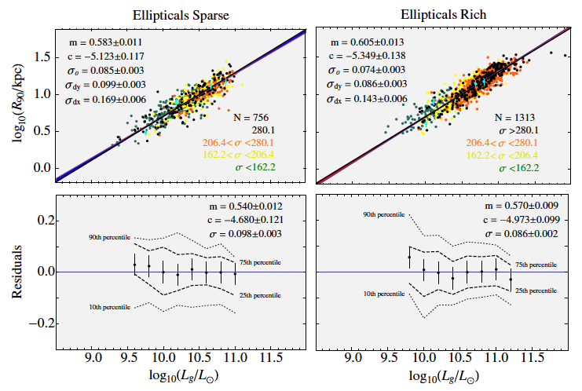
  The luminosity-size relation
  Hyde & Bernardi (‘09) find curvature, but Nair et al. (‘11) do not. Sample selection by Hyde & Bernardi, based on concentration, includes disk galaxies.
Nair et al. (’11) suggest the scatter is so low, it could be a challenge for building ellipticals through mergers
Francesco Lucchin PhD School – Erice 2011
Dimitri Gadotti (ESO)

Slide 44
What these relations tell us?
  Systematic properties come from gravity acting
  Deviations are due to other forces, such as gas physics (dissipation, supernovae feedback, AGN feedback…): other formation histories
  Luminosity (Mass)-Size relation indicates how things grow
Francesco Lucchin PhD School – Erice 2011
Dimitri Gadotti (ESO)

Slide 45
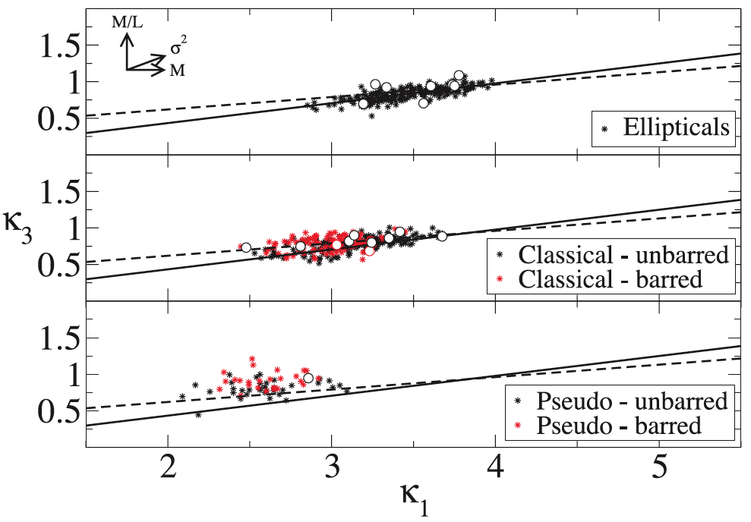
Where do bulges and ellipticals fall in the edge-on view of the FP?
Disk-like bulges and classical bulges deviate from ellipticals, the former more noticeably than the latter (the dashed line is from Bernardi et al. ‘03). There is no clear distinction between barred and unbarred galaxies (although perhaps a slight offset).
Gadotti ‘09
Francesco Lucchin PhD School – Erice 2011
Dimitri Gadotti (ESO)

Slide 46
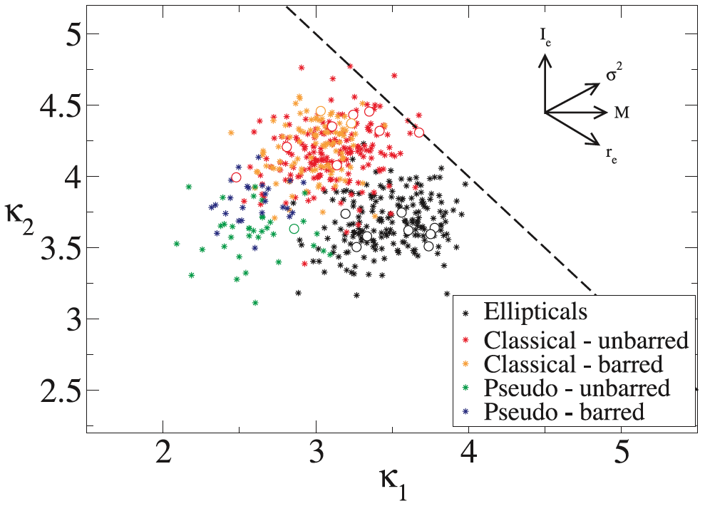
Where do bulges and ellipticals fall in the face-on view of the FP?
The 3 systems occupy very different loci! Again, there seems to be a difference for barred galaxies.
Gadotti ‘09
Francesco Lucchin PhD School – Erice 2011
Dimitri Gadotti (ESO)

Slide 47
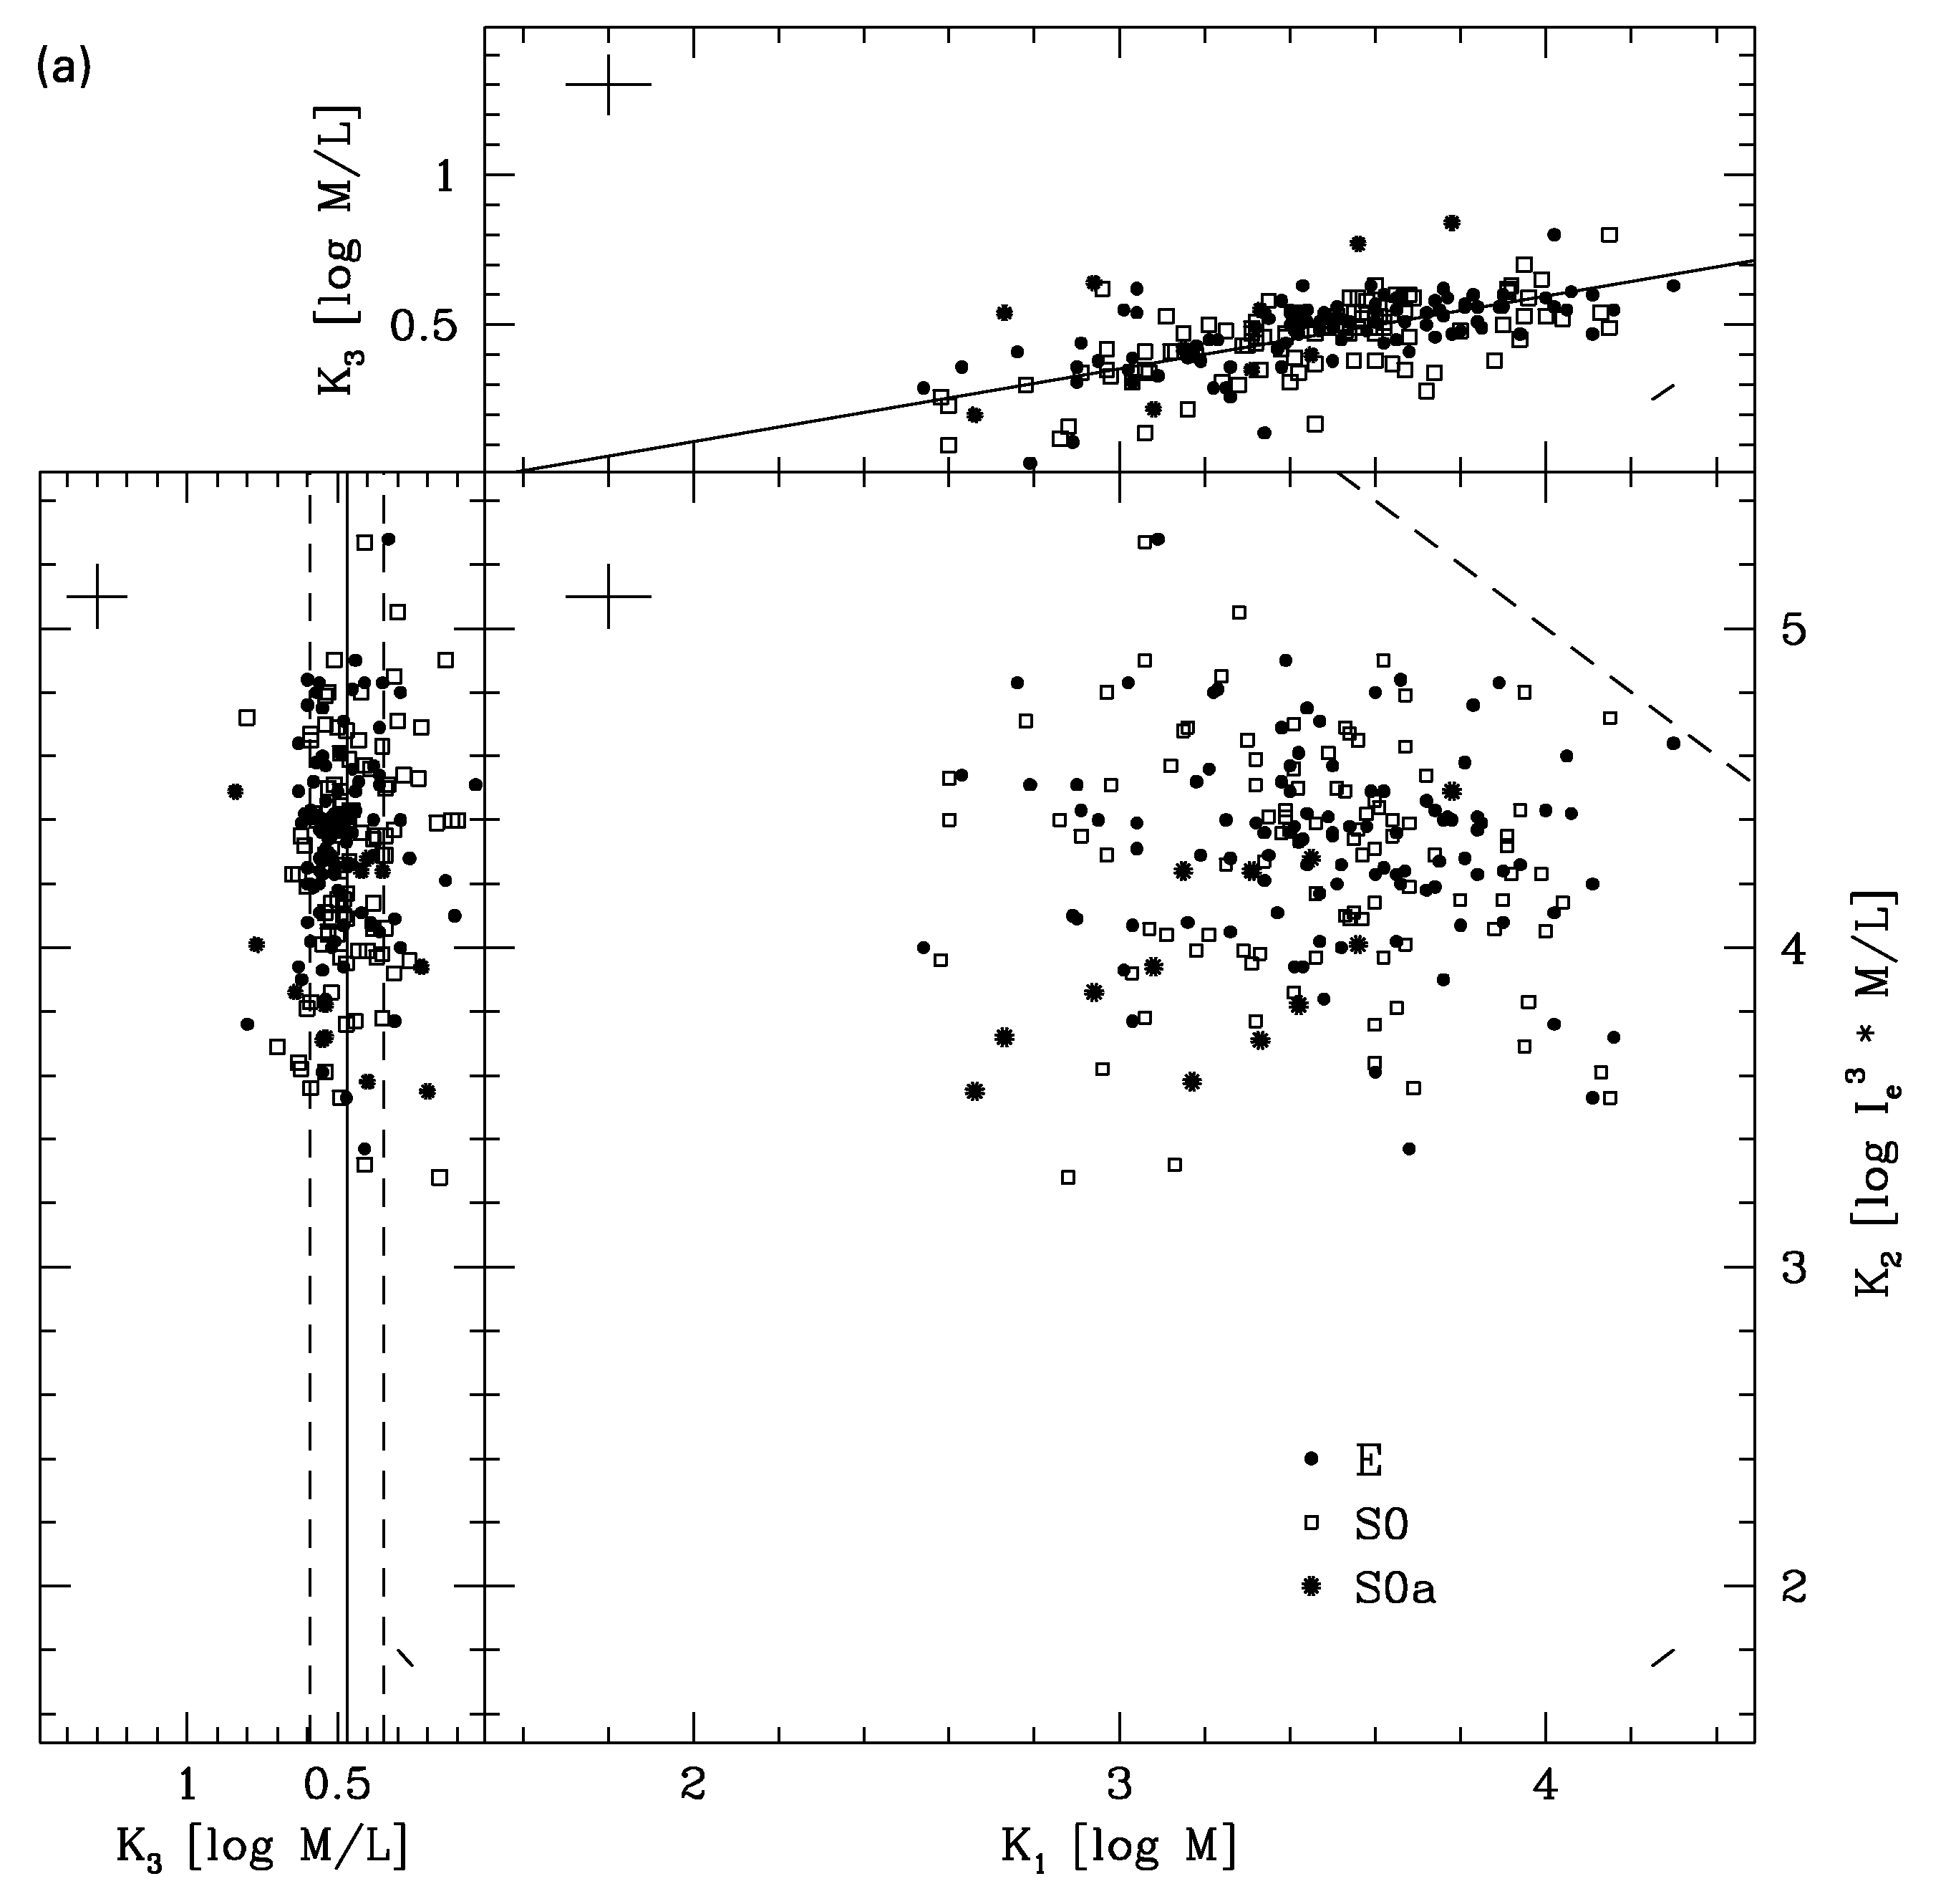
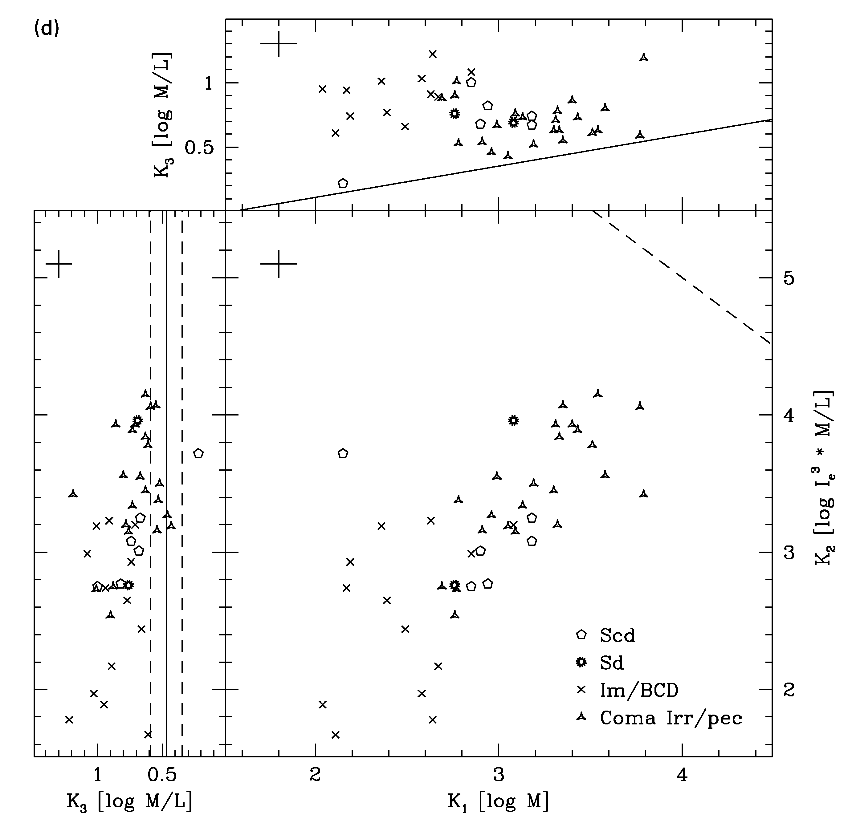
The locus occupied by disk-like bulges is the same as pure disk systems, as seen in the H-band FP of Pierini et al. (‘02).
early-type
late-type
Francesco Lucchin PhD School – Erice 2011
Dimitri Gadotti (ESO)

Slide 48
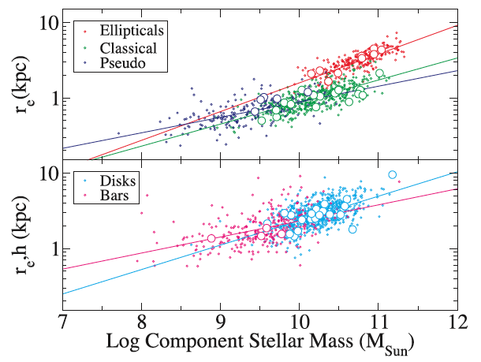
How the mass-size relation of bulges and ellipticals compare?
log (size) = alpha × log (mass)
bars: α=0.21
disks: α=0.33
disk-like: α=0.20 (±0.02)
classical: α=0.30
ellipticals: α=0.38
Francesco Lucchin PhD School – Erice 2011
Dimitri Gadotti (ESO)

Slide 49
  The mass-size relation of disk-like bulges is different from that of classical bulges by 5σ
  The mass-size relation of classical bulges is different from that of ellipticals by 4σ
  The only pair of components with similar mass-size relations are disk-like bulges and bars
bars: α=0.21
disks: α=0.33
pseudo: α=0.20 (±0.02)
classical: α=0.30
ellipticals: α=0.38
Francesco Lucchin PhD School – Erice 2011
Dimitri Gadotti (ESO)

Slide 50
  At the high-mass end, classical bulges are not just ellipticals surrounded by disks
bars: α=0.21
disks: α=0.33
pseudo: α=0.20 (±0.02)
classical: α=0.30
ellipticals: α=0.38
Francesco Lucchin PhD School – Erice 2011
Dimitri Gadotti (ESO)

Slide 51
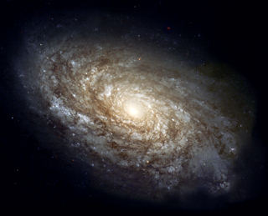
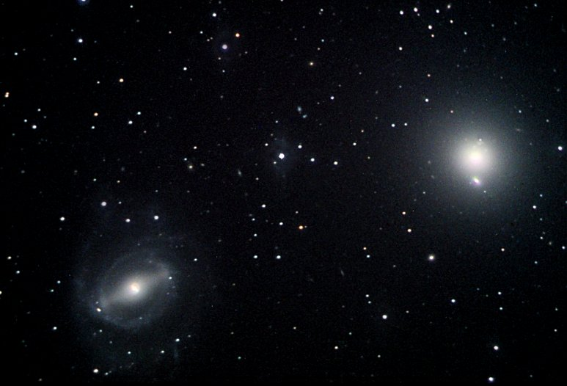
The Stellar Mass Budget at Redshift Zero
For galaxies with stellar mass > 10¹⁰ M_{Sun}
~ 36% in disks
~ 3% in disk-like bulges
~ 4% in bars
~ 32% in elliptical galaxies
~ 25% in classical bulges
Gadotti ‘09
Francesco Lucchin PhD School – Erice 2011
Dimitri Gadotti (ESO)

