Slide 1
Pseudo-bulges, classical bulges and
elliptical galaxies – II
Monsters at Heart
Dimitri Gadotti (ESO)

Slide 2
Outline – Lecture Two
Composite bulges
Host galaxies and environment
Elliptical galaxies and two dichotomies
core-depleted vs. extra-light
giants vs. dwarfs
Supermassive black holes and their scaling relations
Bulge formation models
Some thoughts on future research
Francesco Lucchin PhD School – Erice 2011
Dimitri Gadotti (ESO)

Slide 3
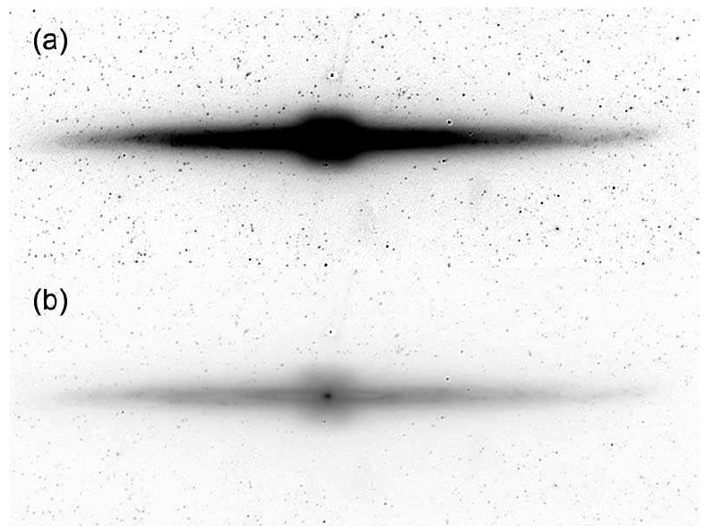
Composite Bulges
It is evident that a single galaxy can have a classical bulge AND a disk-like bulge. It can also have a box/peanut (see e.g. Kormendy & Barentine ‘10).
IRAC-1 image of NGC 4565. The disk-like bulge is the tiny structure in the center.
Francesco Lucchin PhD School – Erice 2011
Dimitri Gadotti (ESO)

Slide 4
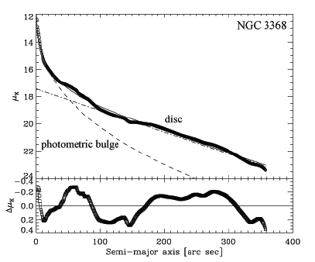
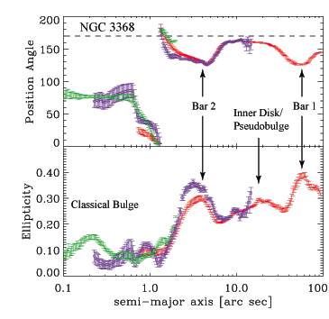
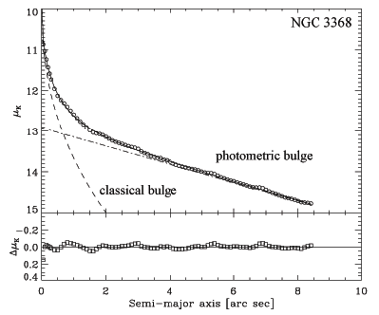
Composite Bulges
Nowak et al. (‘10) argue that they find two galaxies with a small classical bulge inside a disk-like bulge.
Francesco Lucchin PhD School – Erice 2011
Dimitri Gadotti (ESO)

Slide 5
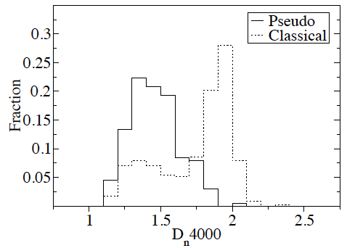
Composite Bulges
Gadotti (’09) suggests that the presence of small star-forming disk-like bulges inside classical bulges can be relatively common.
These bulges are structurally like classical bulges, but show high on-going star formation activity, like disk-like bulges.
low D_{n}4000 means high on-going star formation activity
Francesco Lucchin PhD School – Erice 2011
Dimitri Gadotti (ESO)

Slide 6
Host Galaxies and Environment
Having low B/T, galaxies with disk-like bulges are naturally late-type spirals. Durbala et al. (‘08) find them to be predominantly in low density environments.
Mathur et al. (‘11) and De Xivry et al. (‘11) show evidence that galaxies that are narrow-line Seyferts type 1 (NLS1) host disk-like bulges. High accretion rates might be fuelled by bars.
(NLS1: small black holes, high accretion rates.)
Francesco Lucchin PhD School – Erice 2011
Dimitri Gadotti (ESO)

Slide 7
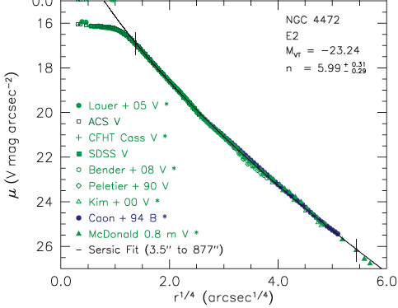
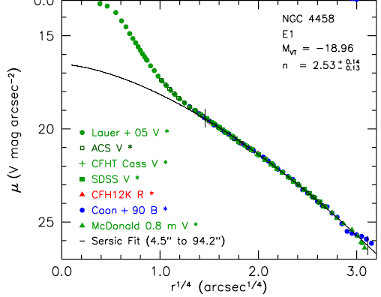
Elliptical Galaxies
Although there is no consensus in the literature, there are suggestions that elliptical galaxies are characterized by two dichotomies (see e.g. Graham et al. ‘03; Trujillo et al. ‘04; Ferrarese et al. ‘06; Kormendy et al. ’09; Graham ‘11):
core-depleted vs. extra-light (coreless; power-law)
At M_{B} ~ -20.5
Kormendy et al. ‘09
core-depleted
extra-light
Francesco Lucchin PhD School – Erice 2011
Dimitri Gadotti (ESO)

Slide 8
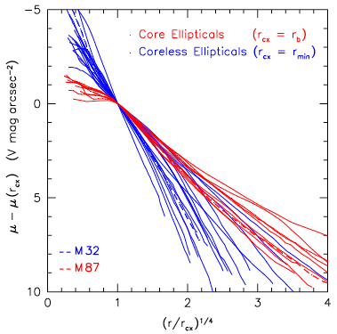
Elliptical Galaxies
Kormendy et al. ‘09
Francesco Lucchin PhD School – Erice 2011
Dimitri Gadotti (ESO)

Slide 9
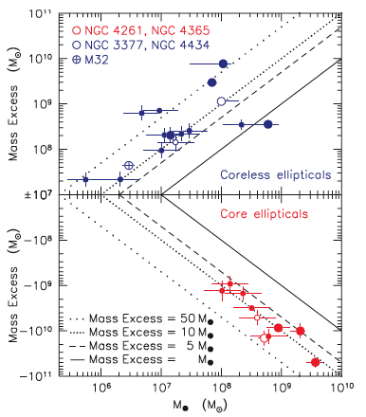
Elliptical Galaxies
Mass deficits in core galaxies are probably caused by the slingshot effect of binary supermassive black holes in dissipationless mergers. Stars can even be ejected from galaxy!
Might give an indication of how many mergers.
Kormendy et al. ‘09
Francesco Lucchin PhD School – Erice 2011
Dimitri Gadotti (ESO)

Slide 10
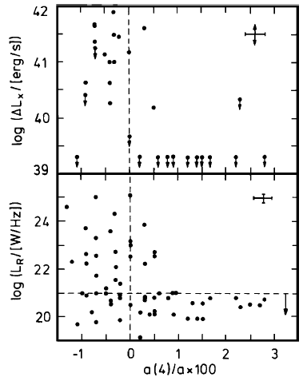
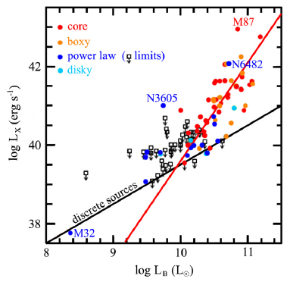
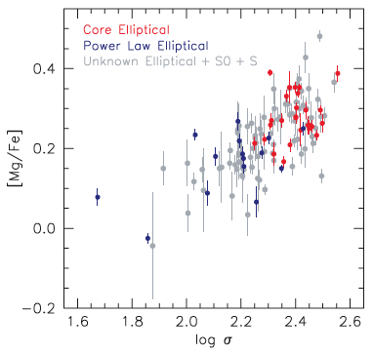
Elliptical Galaxies
Core galaxies rotate slowly, have boxy shape, are radio-bright, X-ray-bright and α-enhanced, as compared to extra-light galaxies (Kormendy et al. ‘09).
Francesco Lucchin PhD School – Erice 2011
Dimitri Gadotti (ESO)

Slide 11
Elliptical Galaxies
Kormendy et al. (‘09) suggest that core ellipticals form via dry, dissipationless mergers. They are also kept with a core due to the heating of external gas through AGN feedback.
Extra-light ellipticals would thus form via wet, dissipative mergers. Starbursts would occur in these mergers and originate the extra component.
Francesco Lucchin PhD School – Erice 2011
Dimitri Gadotti (ESO)

Slide 12
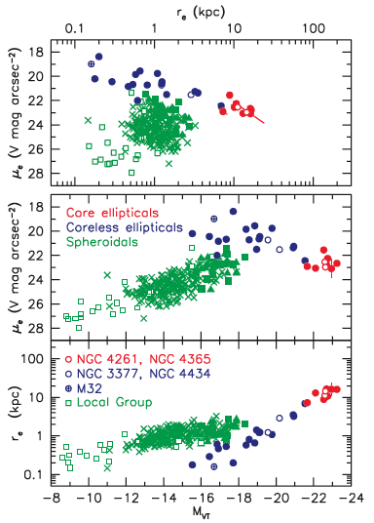
Elliptical Galaxies
giants (bright) vs. dwarfs (faint; spheroidals)
At M_{B} ~ -18
Kormendy et al. ‘09
Francesco Lucchin PhD School – Erice 2011
Dimitri Gadotti (ESO)

Slide 13
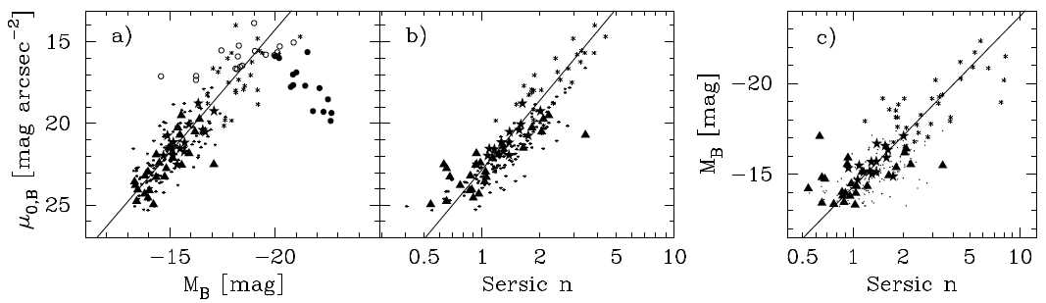
Elliptical Galaxies
Graham (‘11) argues that linear relations between central surface brightness and galaxy luminosity and Sérsic index originate curved relations when one uses effective parameters (r_{e}, μ_{e}).
do core ellipticals deviate just because they have cores?
Francesco Lucchin PhD School – Erice 2011
Dimitri Gadotti (ESO)

Slide 14
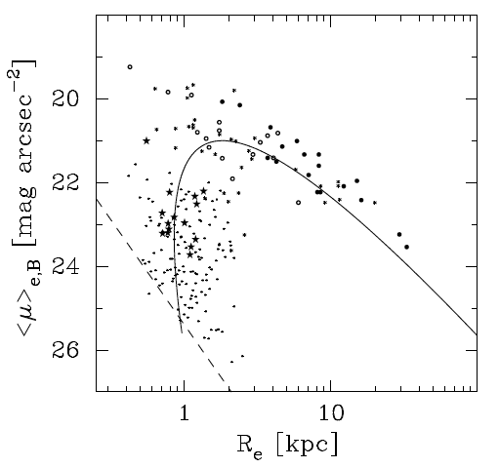
Elliptical Galaxies
Graham (‘11) argues that linear relations between central surface brightness and galaxy luminosity and Sérsic index originate curved relations when one uses effective parameters (r_{e}, μ_{e}).
gap? (might mean dichotomy is real even if a curved relation is mathematically expected. Or a problem in sample selection.)
Francesco Lucchin PhD School – Erice 2011
Dimitri Gadotti (ESO)

Slide 15
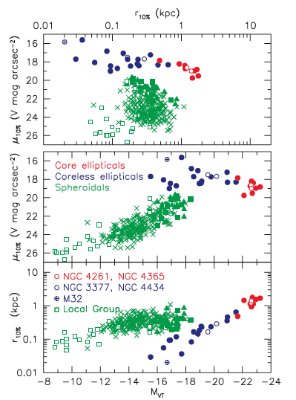
Elliptical Galaxies
overshoot? (maybe a problem for curved relation)
dichotomy appears also for e.g. r_{10%}
Kormendy et al. ‘09
Francesco Lucchin PhD School – Erice 2011
Dimitri Gadotti (ESO)

Slide 16
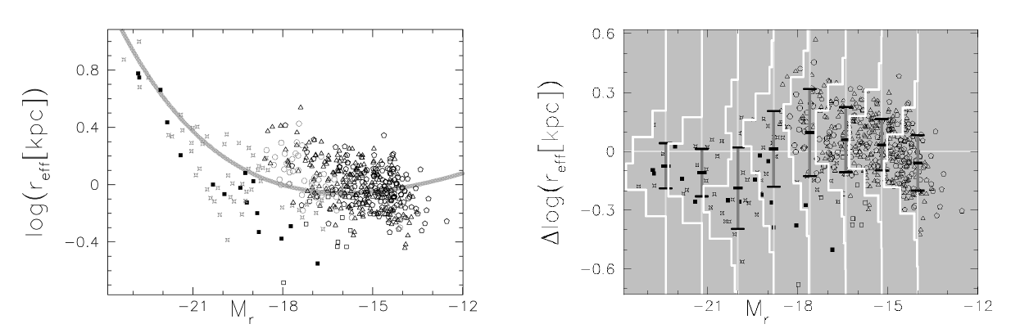
Elliptical Galaxies
Janz & Lisker (‘08) show that curved relation is not a good fit to data. Moreover, scatter indicates a dichotomy.
Francesco Lucchin PhD School – Erice 2011
Dimitri Gadotti (ESO)

Slide 17
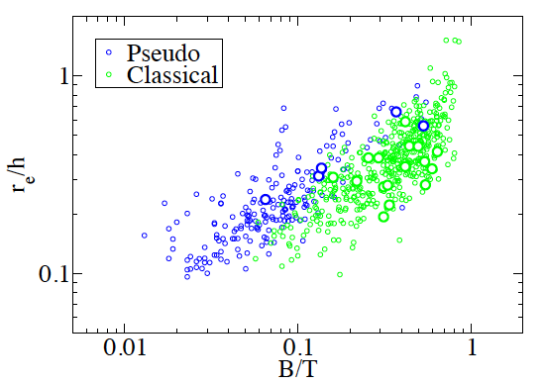
Elliptical Galaxies
Dwarfs are less concentrated than giants for a given luminosity. Presumably, supernovae feedback can reproduce this observation, turning the potential shallower by pushing gas outside.
At a fixed B/T, disk-like bulges are also less concentrated (Gadotti ’09; see also Laurikainen et al. ’07). Evidence of the acting of physics other than gravity.
Graham ‘11
Gadotti ‘09
Francesco Lucchin PhD School – Erice 2011
Dimitri Gadotti (ESO)

Slide 18
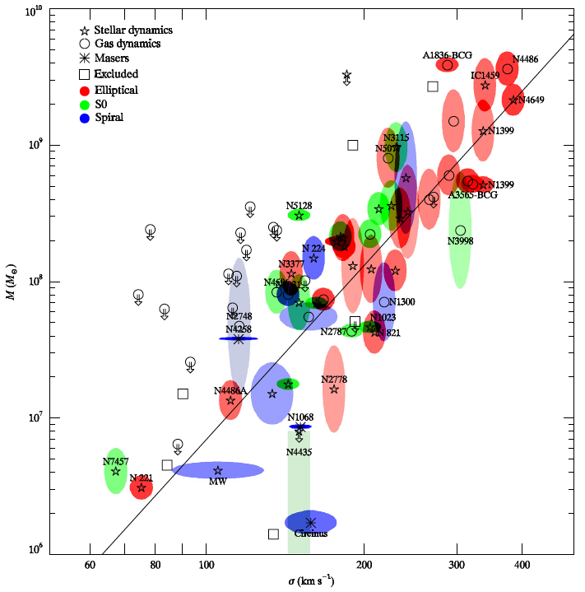
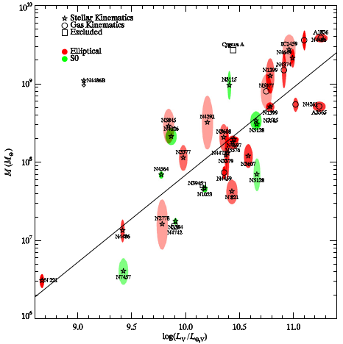
SMBHs and their scaling relations
We think that a SMBH resides at the heart of every (massive) galaxy. Their masses are correlated with central velocity dispersion and bulge luminosity (or mass, see e.g. Gueltekin et al. ‘09).
Francesco Lucchin PhD School – Erice 2011
Dimitri Gadotti (ESO)

Slide 19
SMBHs and their scaling relations
This suggests a connected growth of bulges (and ellipticals) and SMBHs. The latter would accrete mass until AGN feedback regulates the inflow of gas, the growth of the SMBH and the formation of stars in the bulge (or elliptical, see e.g. Younger et al. ‘08).
The building of disk-like bulges would not be connected with the (bulk of the) growth of the SMBHs. Disk-like bulges come after.
Francesco Lucchin PhD School – Erice 2011
Dimitri Gadotti (ESO)

Slide 20
SMBHs and their scaling relations
Graham (’08) shows evidence that barred galaxies increase scatter in the SMBH scaling relations. Hu (‘08) finds different relations for what he classified as pseudo-bulges, a sub-sample which comprises almost exclusively barred galaxies.
Francesco Lucchin PhD School – Erice 2011
Dimitri Gadotti (ESO)

Slide 21
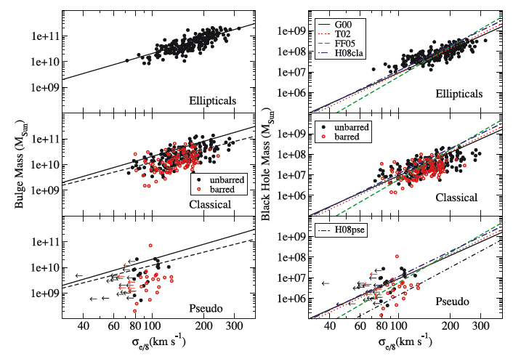
SMBHs and their scaling relations
Gadotti & Kauffmann (‘09) find that barred galaxies deviate from the M_{Bulge}-σ and M_{BH}-σ relations (M_{BH} is derived from Haering & Rix ‘04). Velocity dispersions are too large.
Difference between ellipticals and classical bulges is of 3σ.
Francesco Lucchin PhD School – Erice 2011
Dimitri Gadotti (ESO)

Slide 22
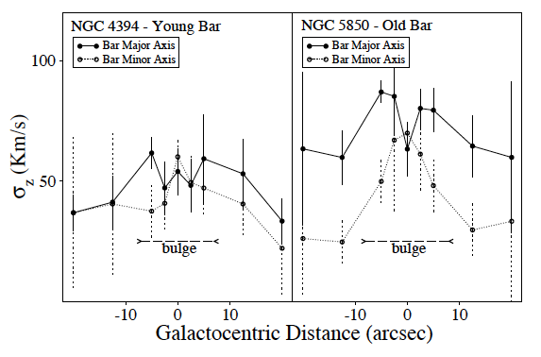
SMBHs and their scaling relations
In barred galaxies (even if seen face-on), velocity dispersion is increased by dynamical processes (e.g. Gadotti & de Souza ‘05).
Francesco Lucchin PhD School – Erice 2011
Dimitri Gadotti (ESO)

Slide 23
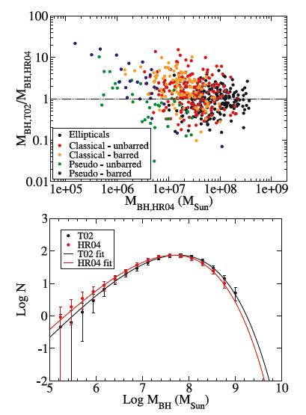
SMBHs and their scaling relations
Total SMBH mass density is 55 per cent larger using M_{BH}-σ relation from Tremaine et al. (‘02), as compared to the M_{BH}-M_{bulge} of Haering & Rix (‘04).
Gadotti & Kauffmann ‘09
Francesco Lucchin PhD School – Erice 2011
Dimitri Gadotti (ESO)

Slide 24
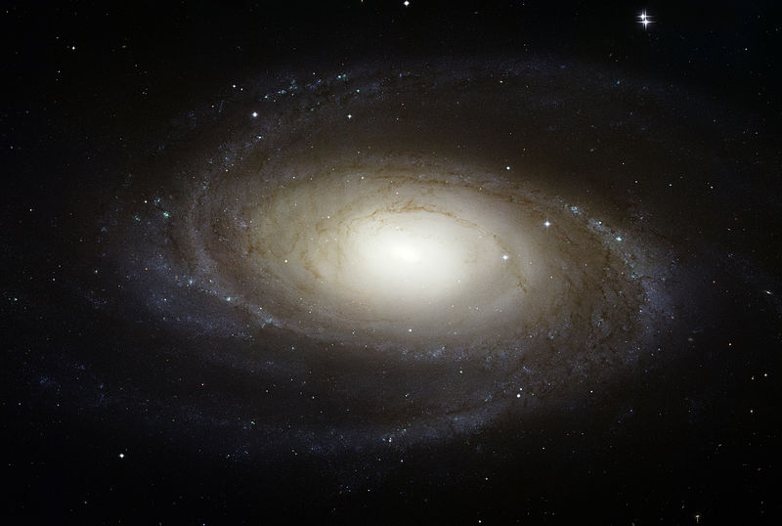
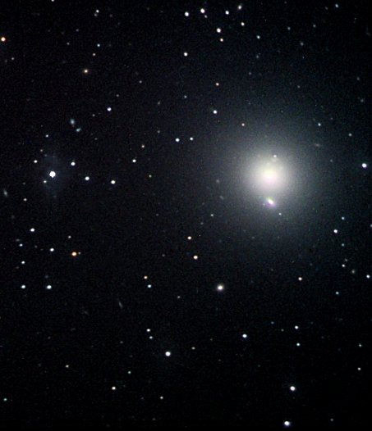
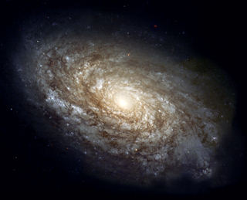
SMBHs and their scaling relations
SMBH mass budget at redshift zero (Gadotti & Kauffmann ‘09) using M_{BH}-M_{Bulge} from Haering & Rix (‘04)
~ 55% in elliptical galaxies
~ 41% in classical bulges
~ 4% in pseudo-bulges
Francesco Lucchin PhD School – Erice 2011
Dimitri Gadotti (ESO)

Slide 25
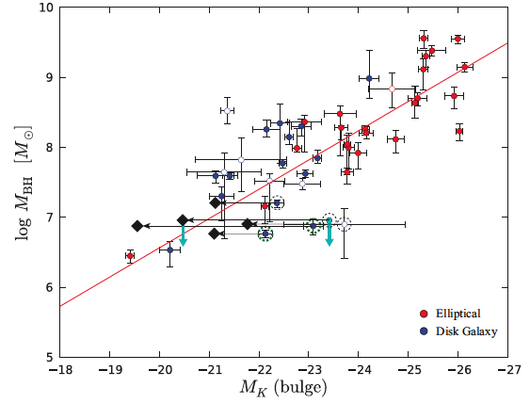
SMBHs and their scaling relations
In galaxies with composite bulges, SMBH correlates better with classical bulge mass only (Erwin ‘10; see also Kormendy et al. ‘11).
Erwin ‘10
Francesco Lucchin PhD School – Erice 2011
Dimitri Gadotti (ESO)

Slide 26
Bulge Formation Models
The essential idea is that ellipticals would have a formation process that significantly involves the merger of smaller units. Time-scales should be shorter for more massive systems (the downsizing scenario, e.g. Cowie et al. ’96), almost approaching monolithic collapse (Eggen et al. ‘62).
Classical bulges could also form through mergers, but differences seen between ellipticals and classical bulges suggest different merger histories, in terms of major/minor merger ratio, dry/wet merger ratio and total number of mergers (see e.g. Hopkins et al. ‘10).
Francesco Lucchin PhD School – Erice 2011
Dimitri Gadotti (ESO)

Slide 27
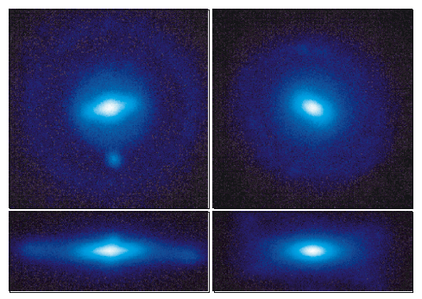
Bulge Formation Models
Formation of low B/T bulges is a challenge for ΛCDM (e.g. Weinzirl et al. ’09), but progress in this direction with N-body simulations is happening. Scannapieco et al. (‘10) report the formation, in the Aquarius simulation, through minor mergers, of bulges with low Sérsic indices (~ 1) and B/T (~ 0.1 – 0.2), albeit with excessive effective radii (see also Governato et al. ‘09, ’10; Brook et al. ‘11).
Scannapieco et al. ‘10
Francesco Lucchin PhD School – Erice 2011
Dimitri Gadotti (ESO)

Slide 28
Bulge Formation Models
Implementation of (disk-like) bulge building via disk instabilities in semi-analytical models is still very crude (Athanassoula ‘08; De Lucia et al. ’11; Guo et al. ‘11): a large fraction (half) of the disk mass is transferred to the bulge if a disk is found to be bar-unstable. This is done to stabilize the disk against bar formation, but we see in Nature now at least half of disk galaxies with prominent bars.
Francesco Lucchin PhD School – Erice 2011
Dimitri Gadotti (ESO)

Slide 29
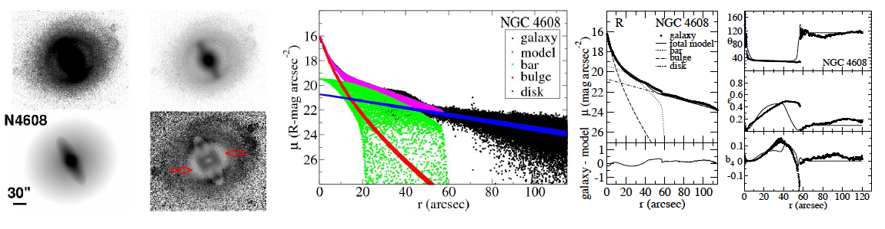
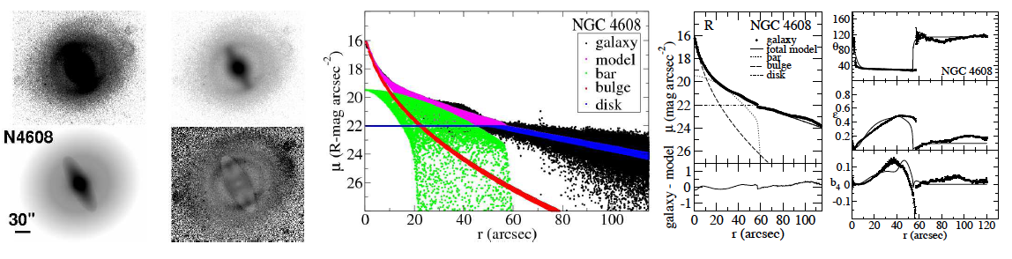
Bulge Formation Models
In extreme cases, mass transfer is about 13 per cent of disk stars (Gadotti ‘08).
Francesco Lucchin PhD School – Erice 2011
Dimitri Gadotti (ESO)

Slide 30
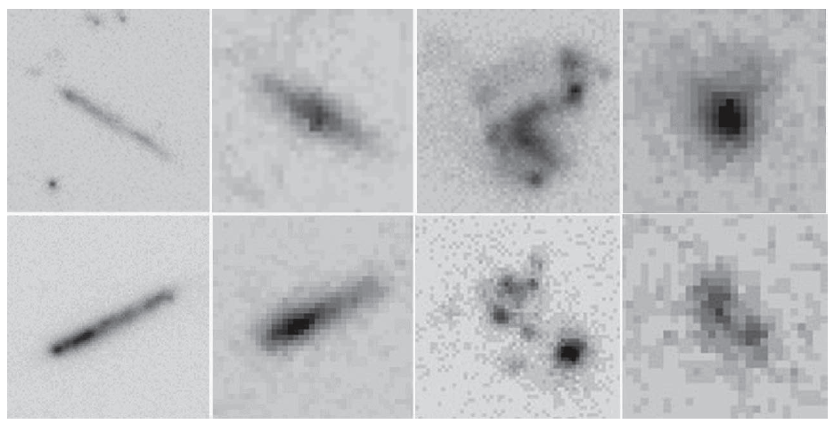
Bulge Formation Models
Coalescence of giant clumps in primordial disk galaxies is also a viable way to form (classical) bulges (Bournaud et al. ‘07; Elmegreen et al. ‘08).
ACS
NICMOS
Elmegreen et al. ‘08
Francesco Lucchin PhD School – Erice 2011
Dimitri Gadotti (ESO)

Slide 31
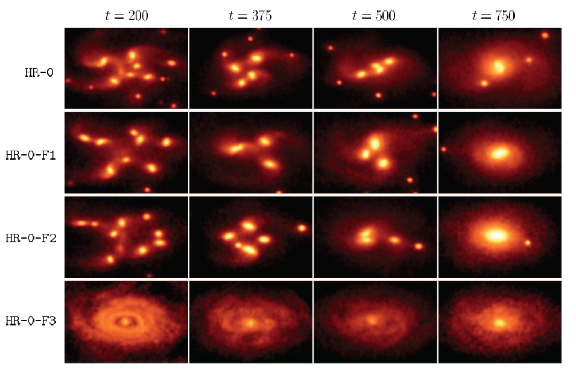
Bulge Formation Models
Coalescence of giant clumps in primordial disk galaxies is also a viable way to form (classical) bulges (Bournaud et al. ‘07; Elmegreen et al. ’08).
Elmegreen et al. ‘08
Francesco Lucchin PhD School – Erice 2011
Dimitri Gadotti (ESO)

Slide 32
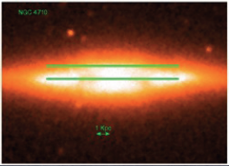
Some Thoughts on Future Research
Galaxies are ghostly, we can see through them. Projection of different components complicates matters. Linking different aspects such as structural analysis and kinematics is revealing. (Think also of chemical evolution, stellar population ages, different wavelengths etc.) I.e., holistic thinking!
A simple example:
kinematics on and above disk plane to study the rotation of bulges (Gadotti et al., in prep.)
Francesco Lucchin PhD School – Erice 2011
Dimitri Gadotti (ESO)

Slide 33
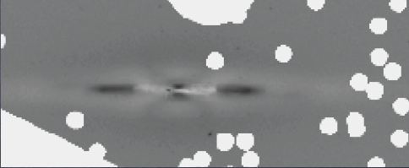
Some Thoughts on Future Research
2D fits with BUDDA (de Souza et al. ’04; Gadotti ‘08) reveal no bulge (galaxy is classified as S0 in RC3), but peanut, and perhaps a ring, or spiral arms. Other galaxies show thick disks. This indicates which kinematics one is really measuring.
Francesco Lucchin PhD School – Erice 2011
Dimitri Gadotti (ESO)

